Slide 1
Web Application Firewall
TEAM ENIGMA
Amogh Avadhani, Ankit Agrahari, Prachi Poddar, Sudeshna Pal

Slide 2

What is WAF?
An HTTP application firewall, which sits in front of the application server and monitors all the incoming traffic.
Filters out malicious traffic.
Guards the server from signature attacks.
Drops requests which deviate from previously seen requests.

Slide 3

Apache Module
WAF is implemented as an Apache Module.
Apache Module enables us to write explicit functionality blocks for the server.
The module is hooked on the server at the appropriate location in the process flow.
Using APR_HOOK_FIRST, the WAF module is called at the beginning of every request.

Slide 4
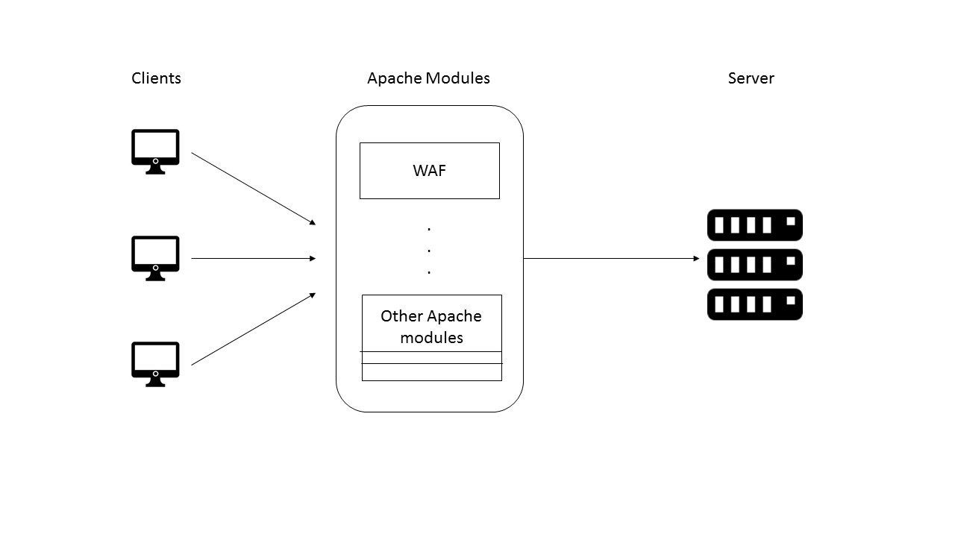
Overview

Slide 5

Detection of Malicious Content: Signatures
Used to prevent well-known attacks.
WAF leverages the signatures to check for these attacks.
It could be extended to identify new attacks in future by adding additional signatures.
Signatures are recognized by the WAF in encoded format.

Slide 6
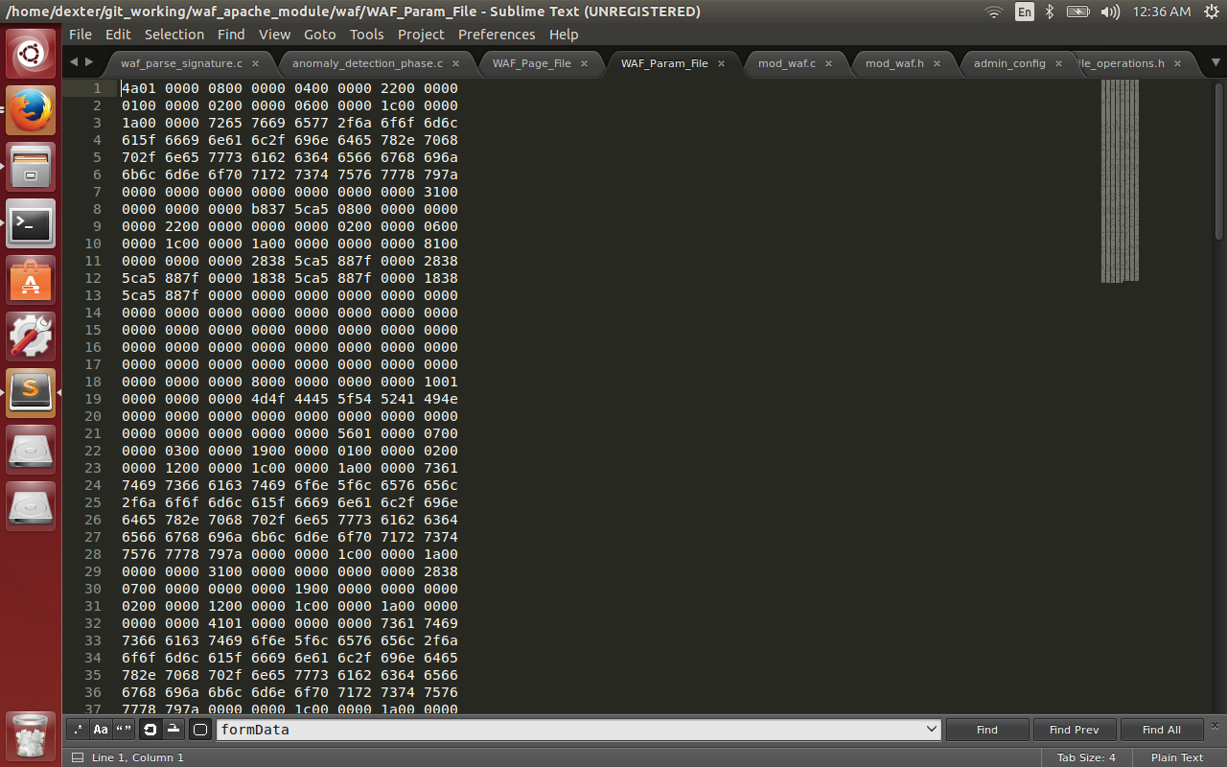
Detection of Malicious Content: Anomaly Detection
Divided into 2 phases: training & detection
In training, WAF learns how legitimate traffic looks like and generates a normality profile (NP).
Data about legitimate traffic is stored in files, in an encrypted format.
NP contains maximum, average and character-set of parameters for each URI.

Slide 7
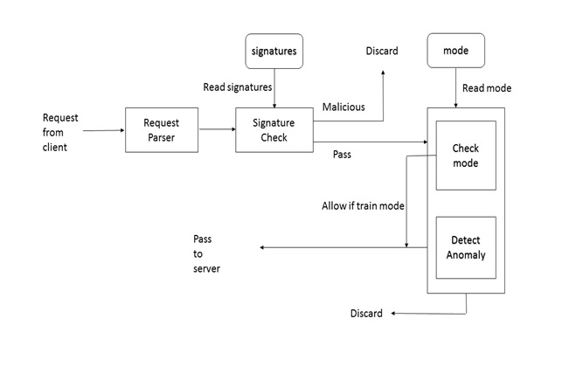
Detection of Malicious Content: Anomaly Detection
In detection, WAF filters out the malicious requests based on the generated profile.
The requests which deviate from the NP are discarded.
Other requests are allowed to go through.

Slide 8
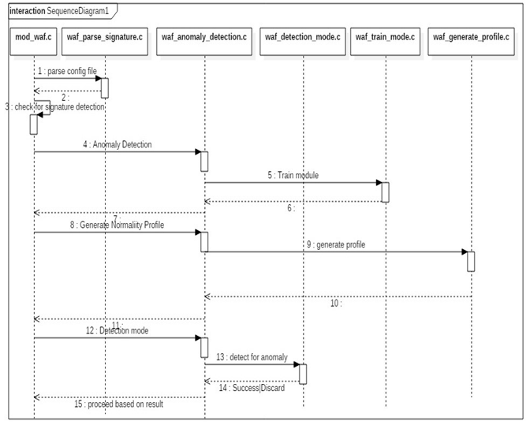
Sequence Flow Diagram

Slide 9

Test Environment: JOOMLA
Joomla is an open source Content Management System (CMS) in which websites and web applications can be created.
The WAF has been tested on a sample e-commerce website created in Joomla CMS and hosted on the Apache server.
The scope of the testing includes both GET and POST requests.
The Use cases include signature verification, anomaly detection – training and anomaly detection - testing.

Slide 10
Teamwork
Amogh Avadhani: Anomaly Detection, Joomla related
Ankit Agrahari: Anomaly Detection, File Storage Operations
Prachi Poddar: Signatures, Anomaly Detection
Sudeshna Pal: Joomla related, Signatures
Summarization and Final Report: Everyone

Slide 11
References
https://httpd.apache.org/docs/2.4/developer/modguide.html
https://httpd.apache.org/docs/current/programs/apxs.html
https://en.Wikipedia.org/wikiWeb_application_firewall
https://github.com/SpiderLabs/ModSecurity
https://www.joomla.org/
http://www.w3schools.com

Slide 12
Thank You!

